Slide 1
WEL COME
DAVID RATHINAM .J
DA&DS mail stone -1 DATE:- 24-07-2024

Slide 2

COFFEE QUVALITY
DATA BASE

Slide 3
Coffee Quality Database
Data Cleaning:
Exploratory Data Analysis (EDA):
Visualization:
Analysis and Interpretation:

Slide 4
Coffee Quality Database
Coffee Quality Dataset
The Coffee Quality Database presents a rich repository of information encompassing various aspects of coffee production and quality evaluation. The objective of this project is to conduct a comprehensive data exploration, cleaning, and analysis to derive meaningful insights from the dataset.
In this project we are going to completely check the datasets for anomalies and missing values , then we are going to rectify all of this by inputting missing values and removing the outliers , etc..

Slide 5
We are mainly going to do Data understanding, preprocessing and visualization. These are crucial steps in data analytics projects as they enable:-
Understanding the data's structure, quality, and patterns
Cleaning and transforming the data for accurate analysis
Communicating insights and findings effectively.
In short, they help extract valuable insights from data, ensure accuracy, and facilitate informed decision-making.

Slide 6
Data Understanding
The Data set initially consisted of 1339 rows and 44 columns. In it:-
24 were object
17 were float
3 were integer
From the dataset we can understand that to relate to quality of the coffee the most suitable column is Total Cup points , which shows us the overall coffee quality

Slide 7
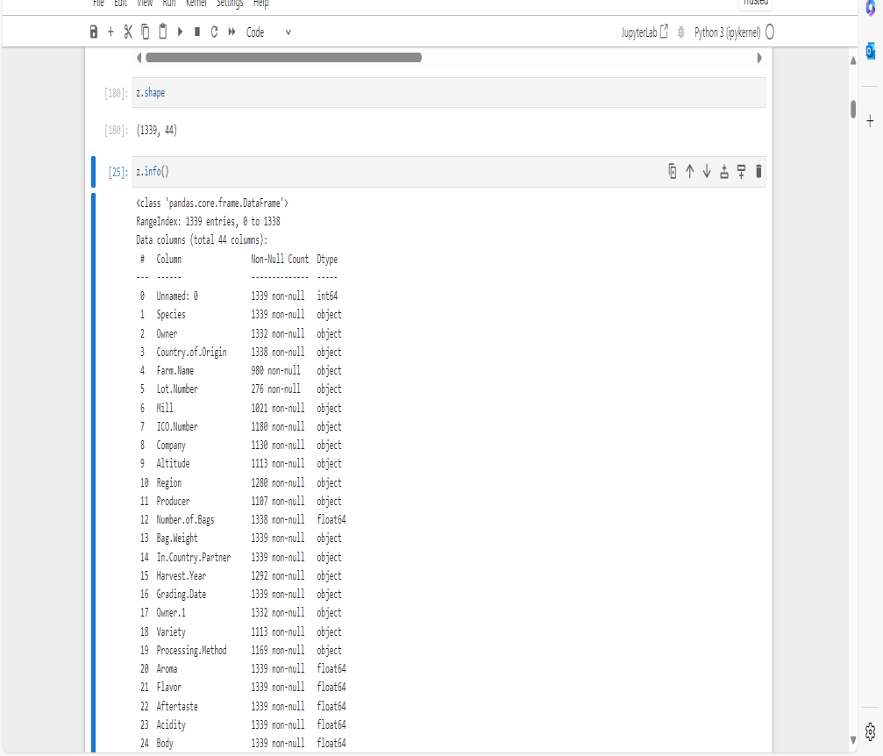
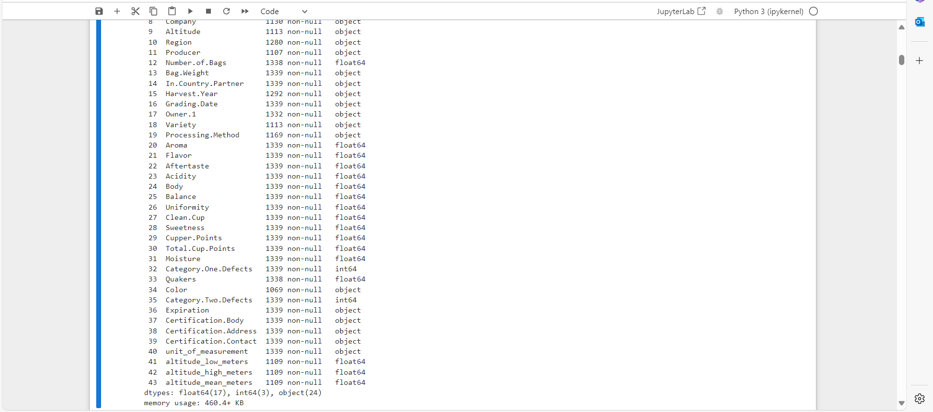
From the dataset we can understand that to relate to quality of the coffee the most suitable column is Total Cup points , which shows us the overall coffee quality

Slide 8
Initial Exploration
From initial dataset when we check we can see a lot of missing values as well as values that are not useful for us for the future analysis as they do not give us any inference on how the quality of the coffee is affected. Going for box plot will show us all the outliers that we need to remove too.

Slide 9
Missing value handling
Missing values needs to be handled carefully. After we finish removing the unwanted columns we go for how many missing inputs are there in the dataset using the “is null().sum()” . Now we check for all the missing values whether they are more than 15% or not. All the values that have above 15% in missing values needs to be discarded. After this we take all those columns with missing values and we use appropriate methods (mean , median & mode)
After missing value imputation and deletion of rows exceeding 15% missing values we can now see that the new data frame has less columns and now it has 1339 rows and 28 columns only.
Before-1339 rows * 44 columns
After-1339 rows * 28 column

Slide 10
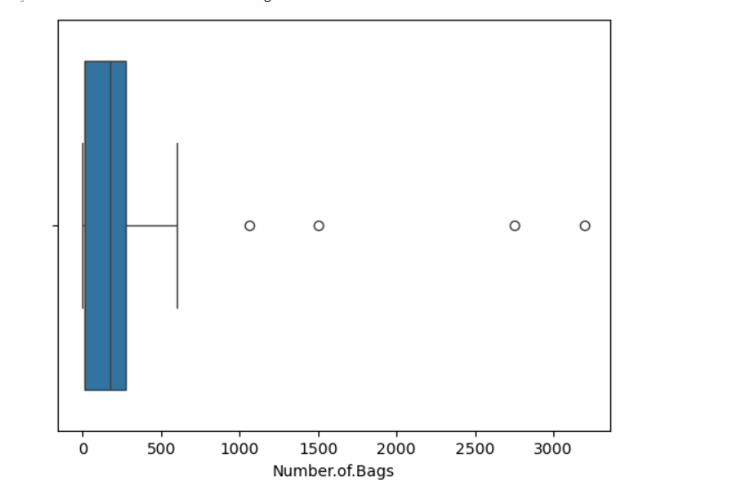
Outlier Handling
Outlier handling is basically to identify and manage extreme values that deviate significantly from the norm. For some values we already did box plot to see that there are outliers present in the datasets. Now to remove all of them we use IQR method. We first remove the categorical values and saved it in a different data frame. Now we check for the Q1 using “.quintile(0.25)” and Q3 using “.quintile(0.75)”. IQR would be Q3-Q1. Now df<(Q1-1.5*IQR) and
df>(Q3+1.5*IQR) would give us the outliers. That is any values on the extreme ends that deviate far from the average values , which if we included would give us skewed values if we do not remove them properly.
Now after getting the outliers and saving it in a variable we can use the NOT Operator to just remove these outliers from our original data frame
This is box plot of number of bags , a numerical value which shows us the presence of outliers
Before-1339 rows * 28 columns
After-592 rows * 28 columns

Slide 11
Invalid Values :-
All data sets would have some values that are invalid which we cannot use nor is it useful in our data analyzation. Such are called invalid values . We need to identify these values and remove them so they do not meddle in our analysis. These may include many types like categorical columns consisting just of a single value , large amount of missing values , etc..
Some of these values we removed included , altitude values which played no significant role in it(also had more than 15% of missing values) , Owner.1 , which played no significance , etc

Slide 12
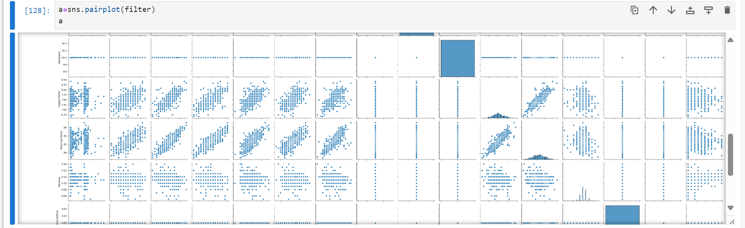
A pair plot is a useful graph that gives an entire overview of the correlations of the data

Slide 13
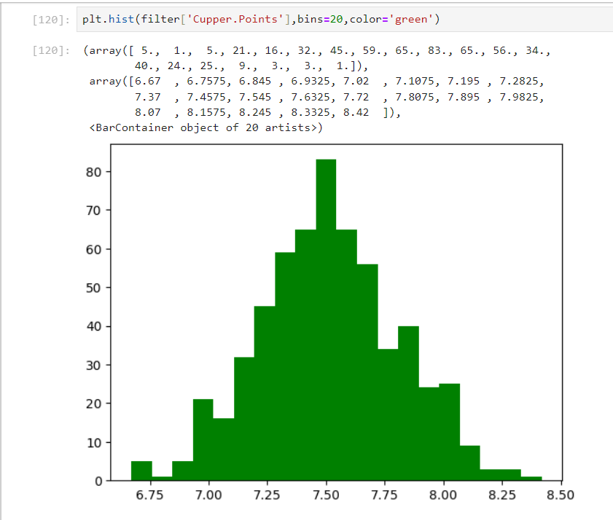
EDA :-
Key insights
Cupper points & flavor is the most dependable values to Total cup points.
Therefore , Flavor & cupper points plays a major role in quality.
There is no value that is highly negatively correlated to total cup points.
Moisture shows a moderately negative correlation
Histogram of cupper points

Slide 14
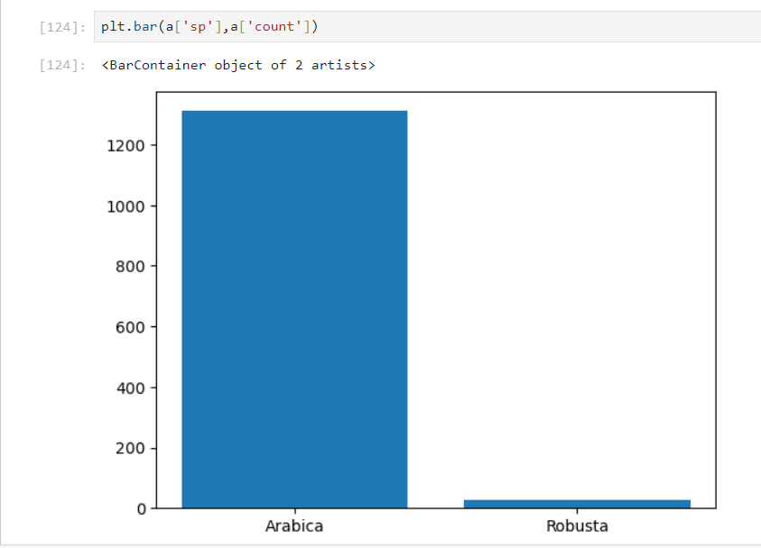
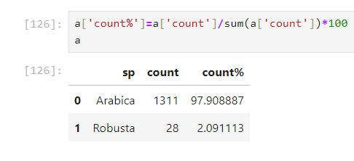
Bar graph of species :-
Showing that out of the 2 species Arabica is almost 98% and Robusta is only 2%

Slide 15
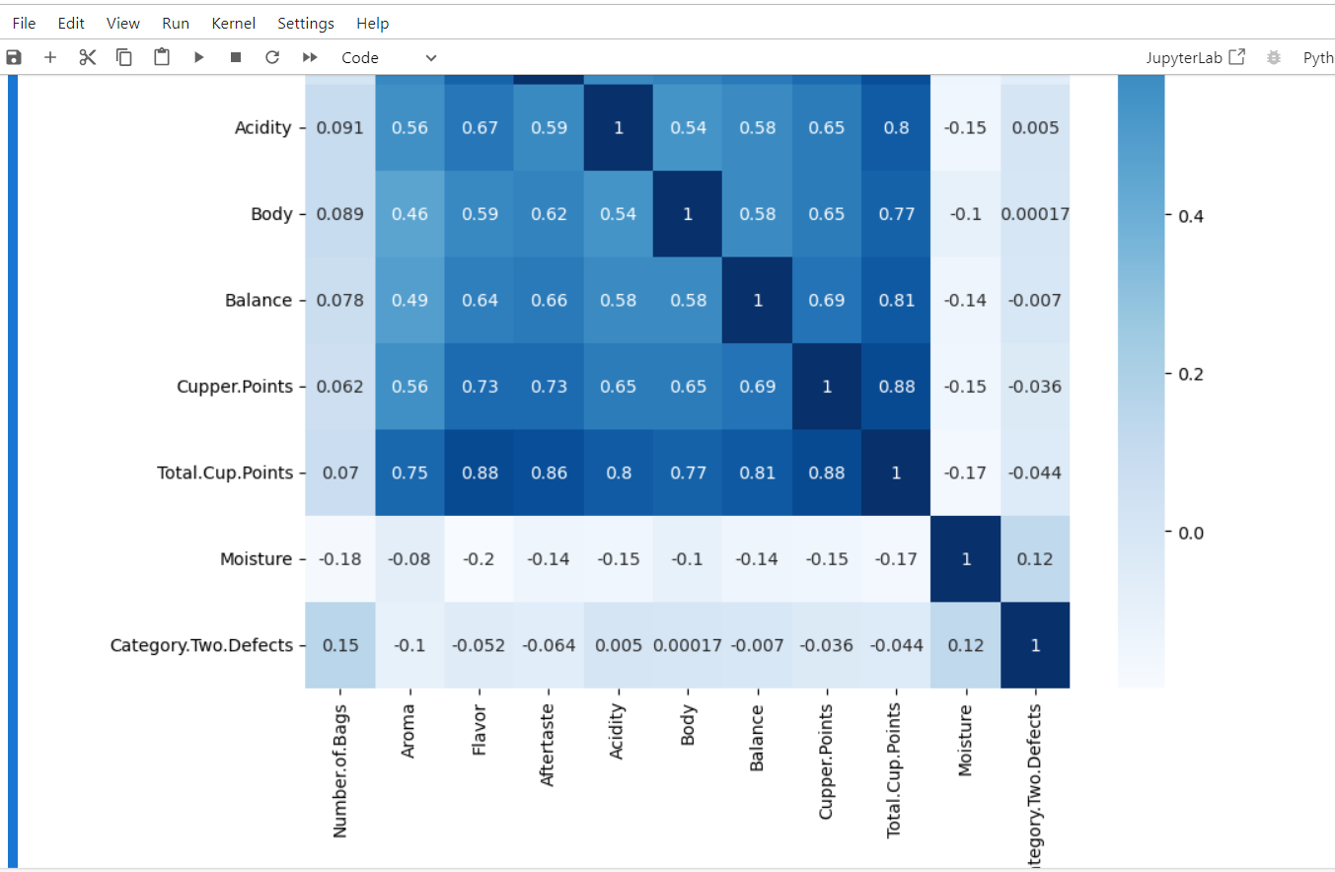
HEAT MAP:-
From this we can see that cupper points & flavor is the most positively correlated with the total cup points. Heat map is useful for this as we can identify the correlation based on the color so it is easy

Slide 16
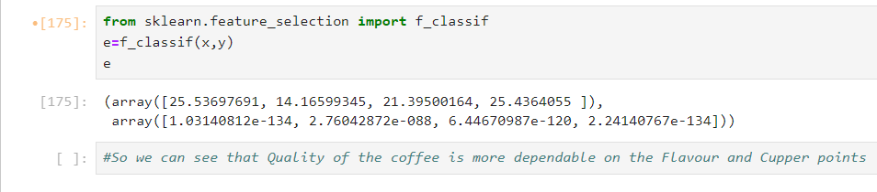
Since first & last column is the closest to 0 we can say that these are the columns most dependable on total cup points
The columns are none other than flavor & cupper points

Slide 17
THANK ING YOU

